Slide 1
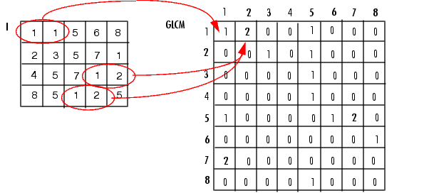

Slide 2
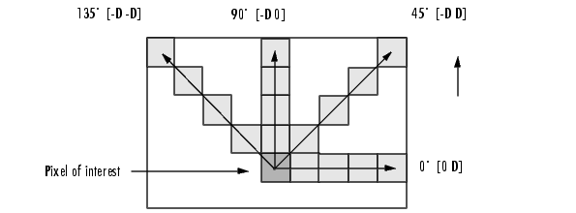

Slide 3
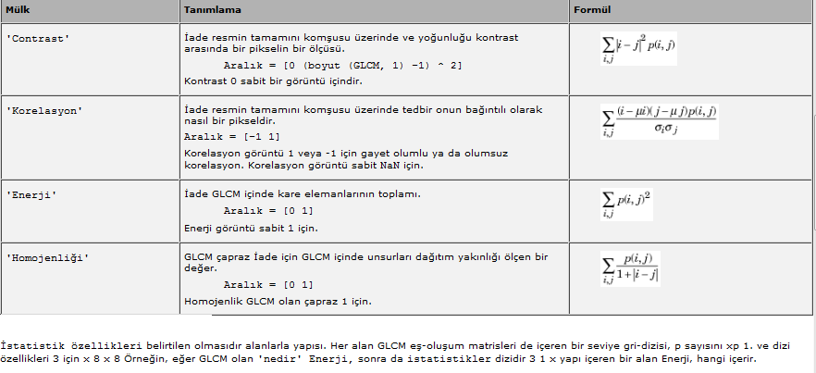
glcm = graycomatrix(I)
stats = graycoprops(glcm,properties)

